Slide 1
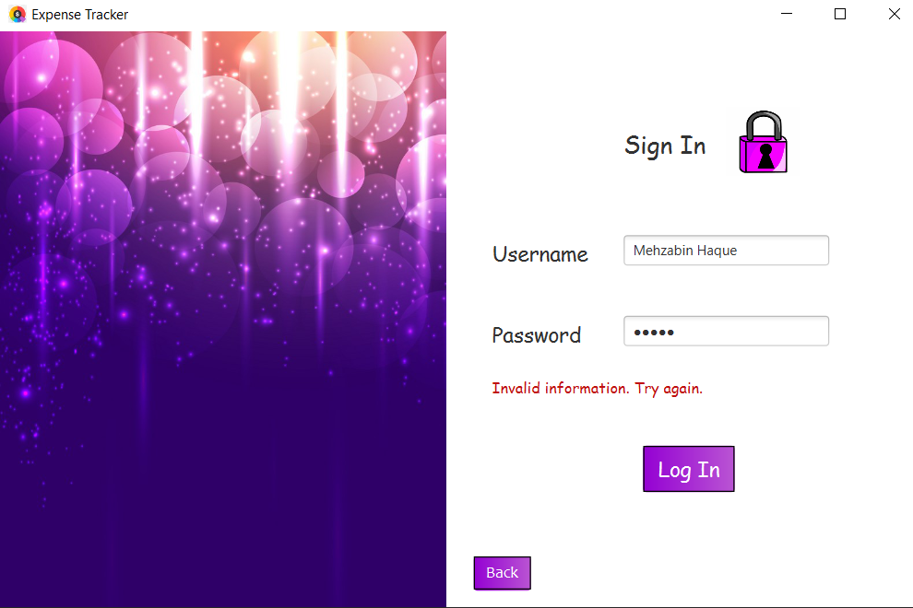
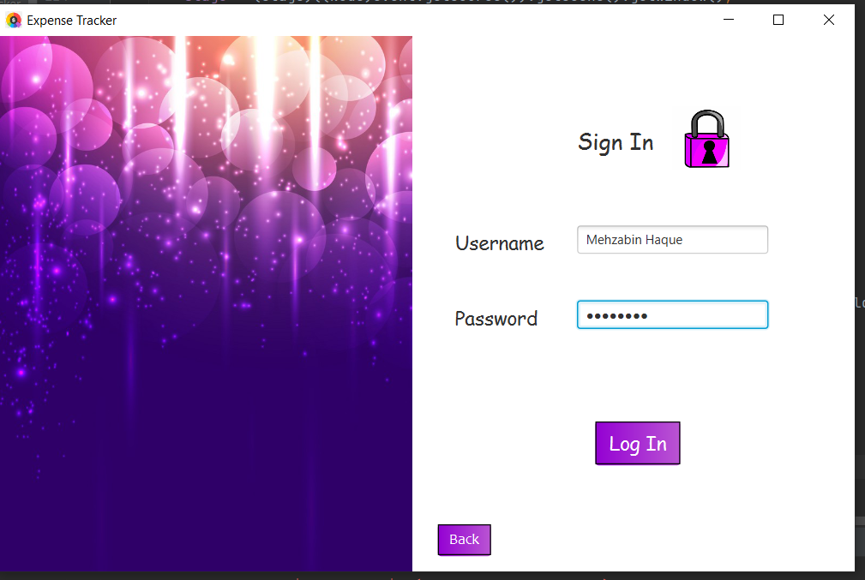

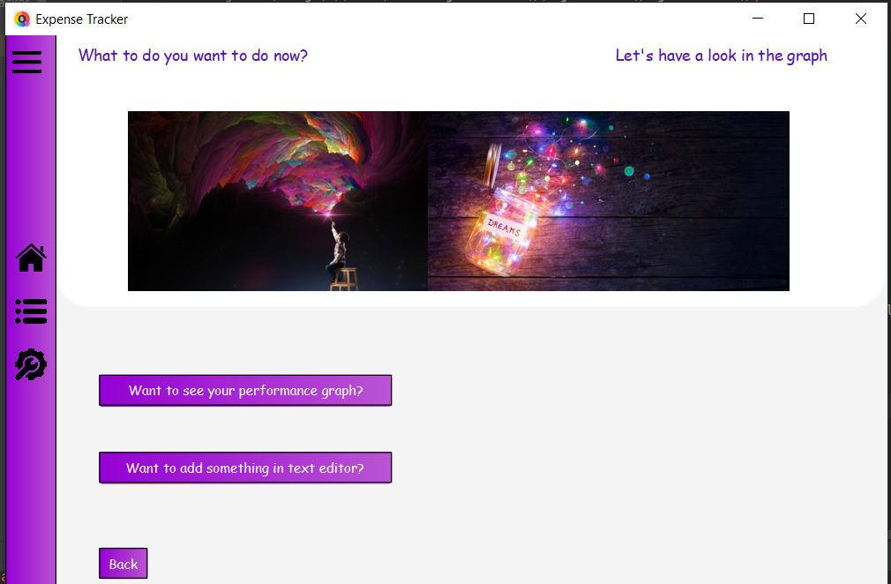
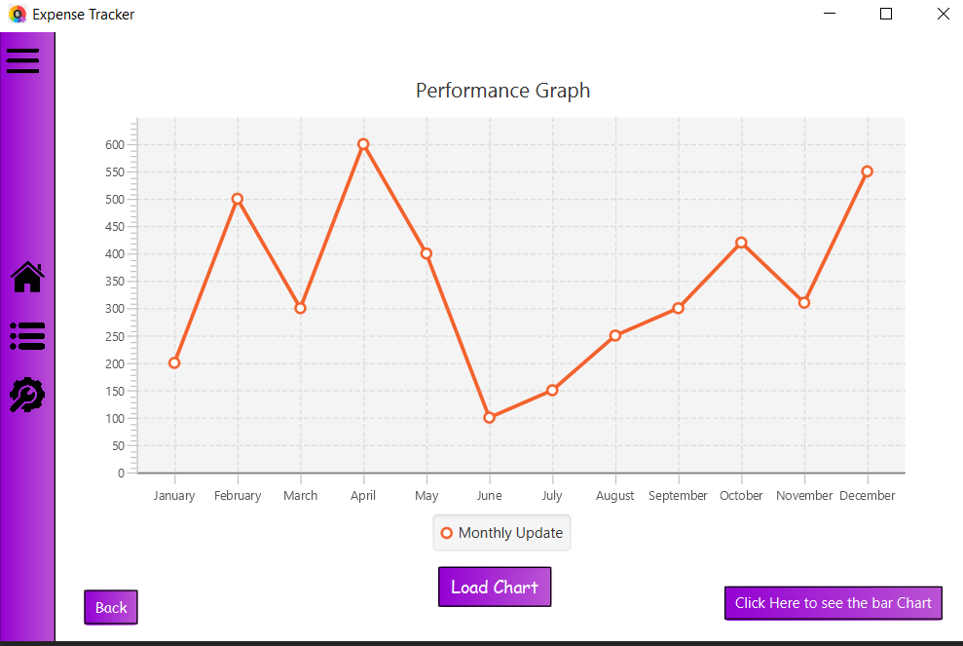
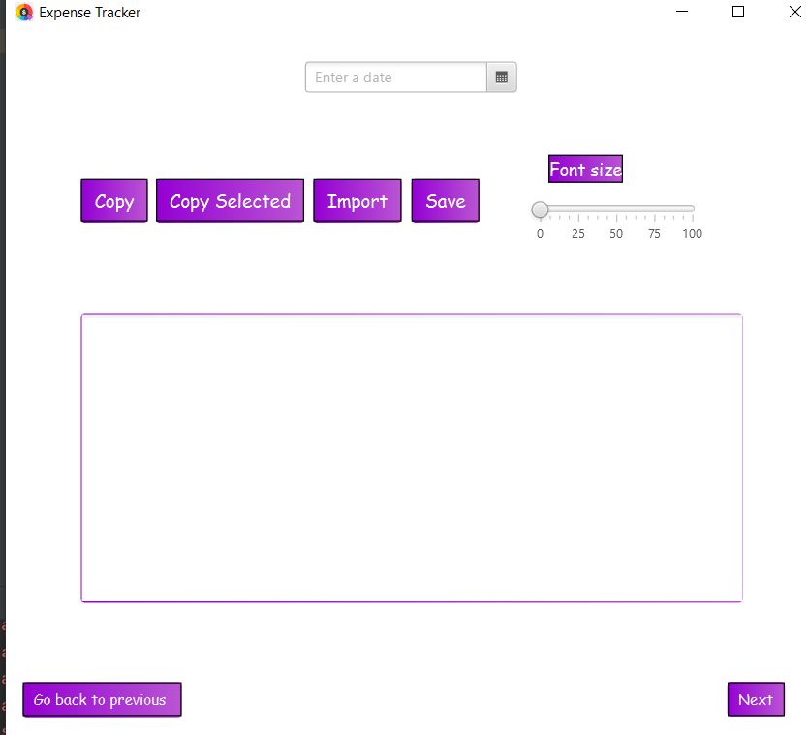
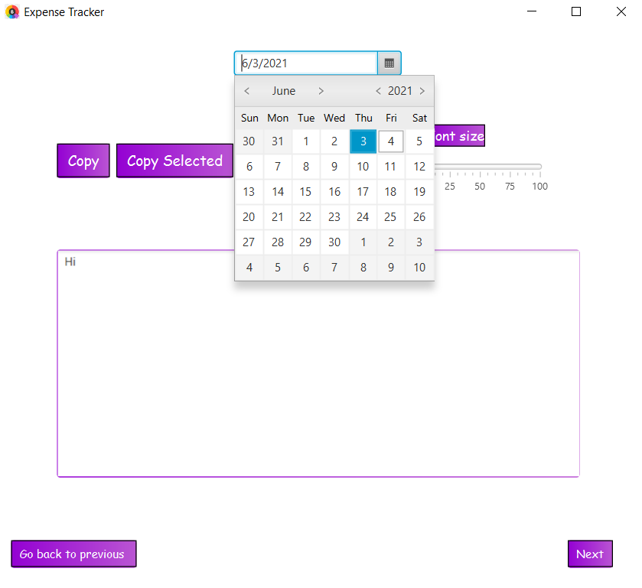
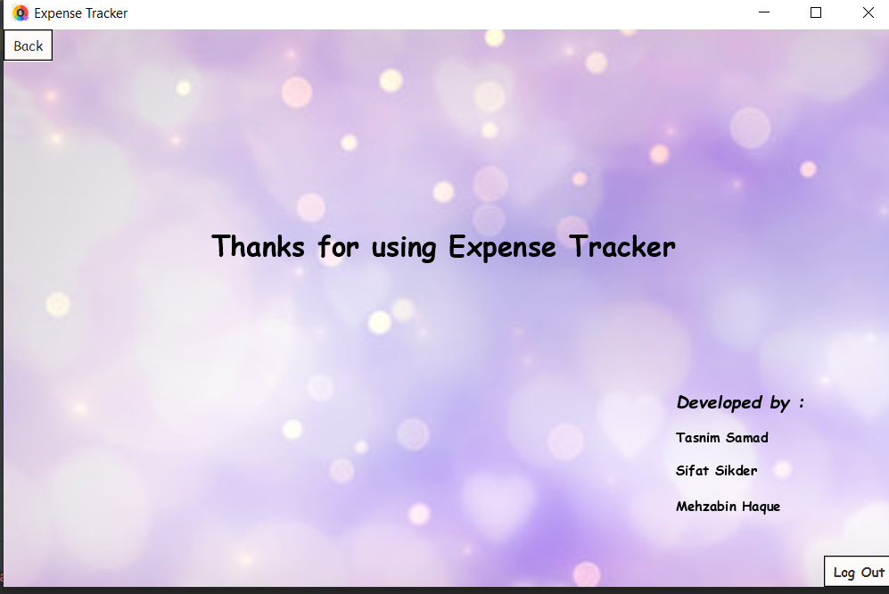

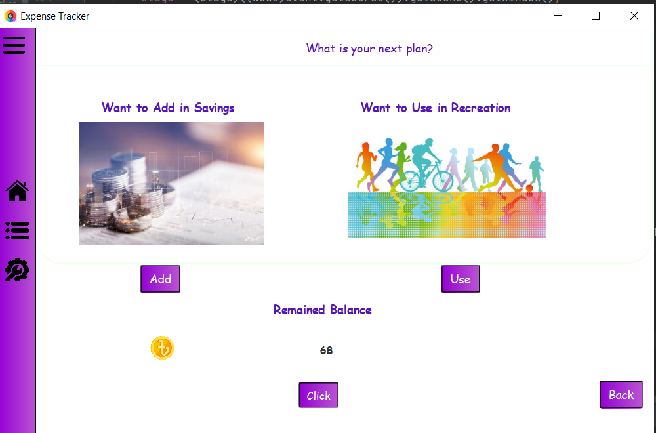
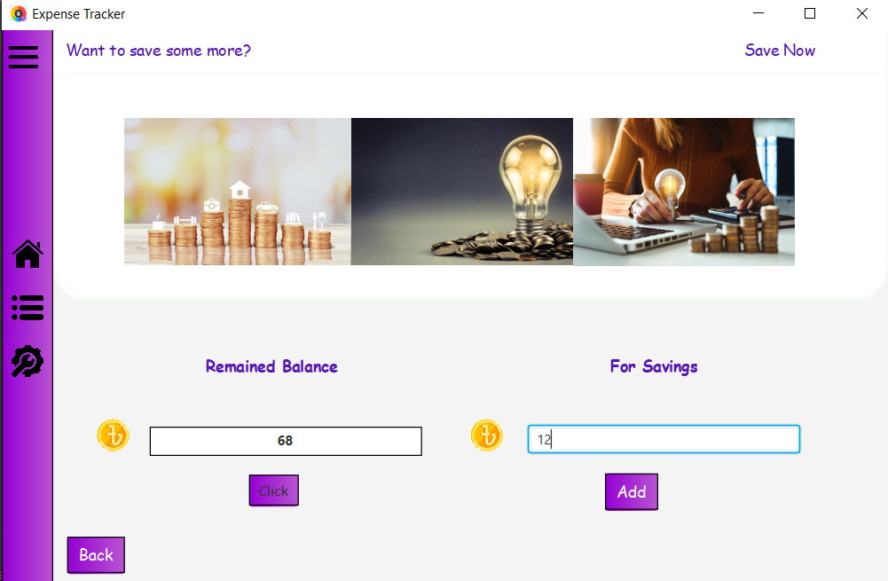
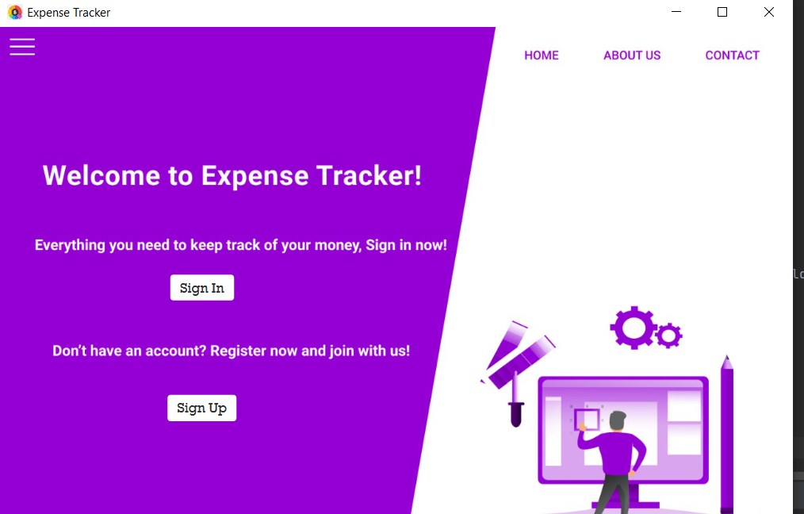
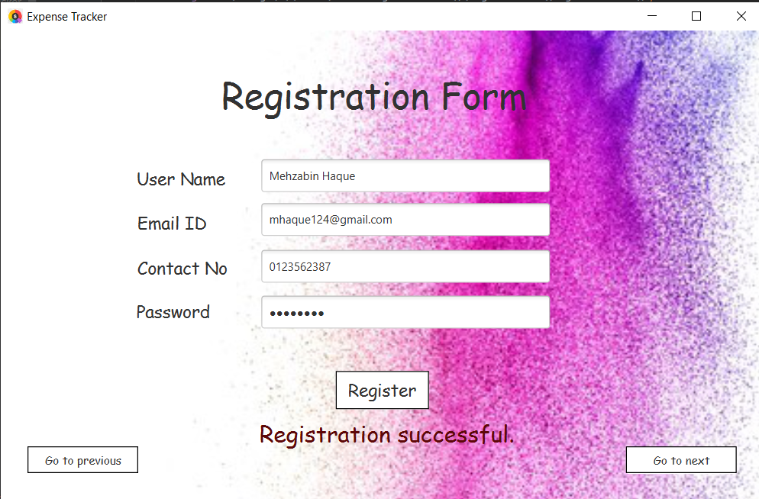
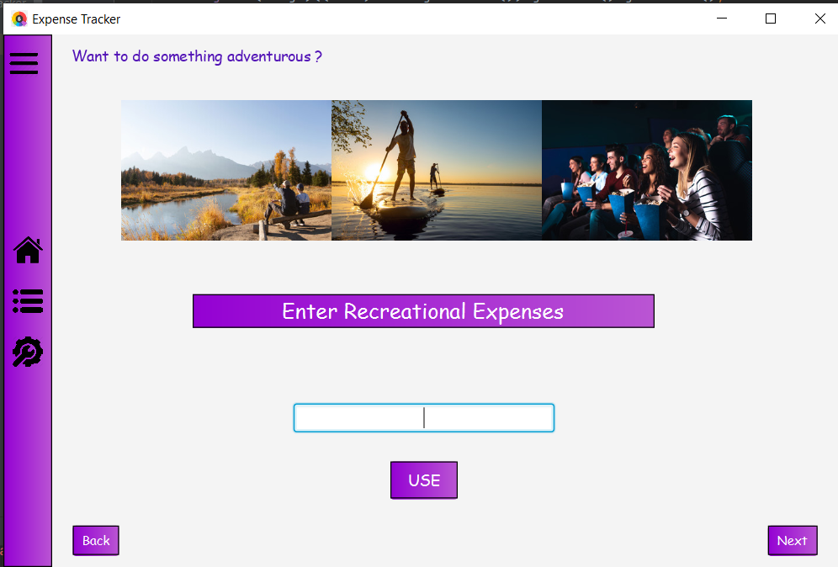
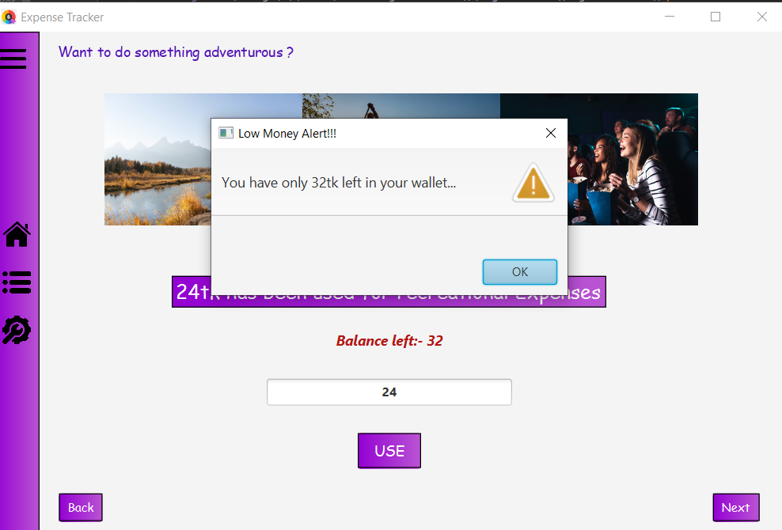
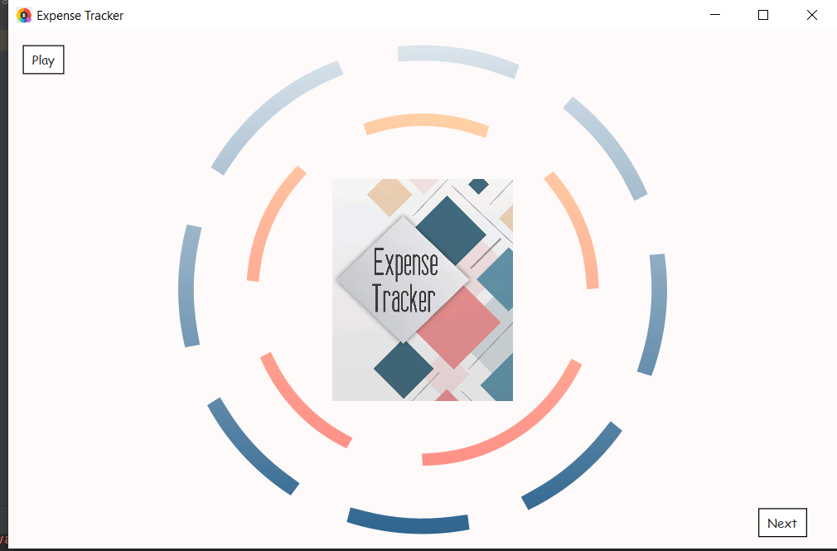
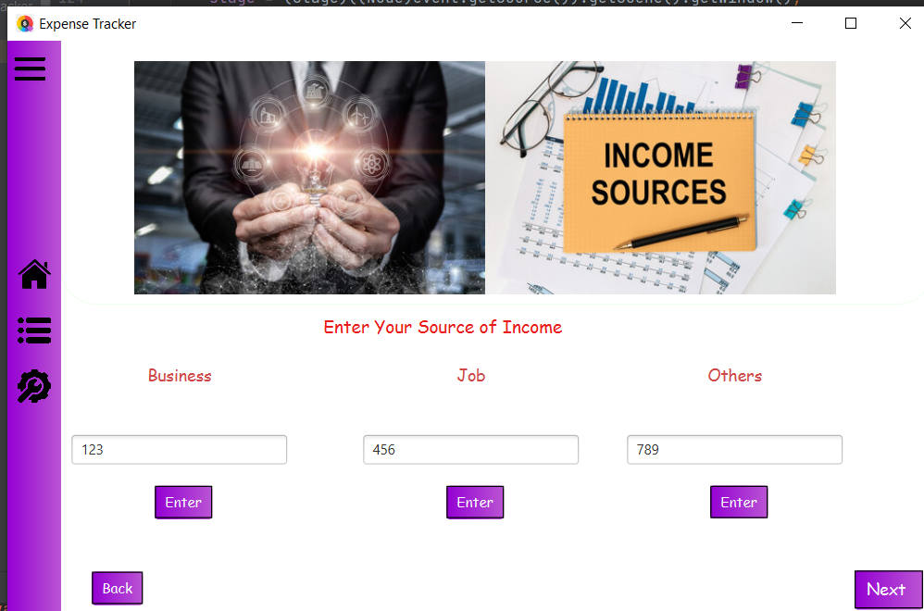
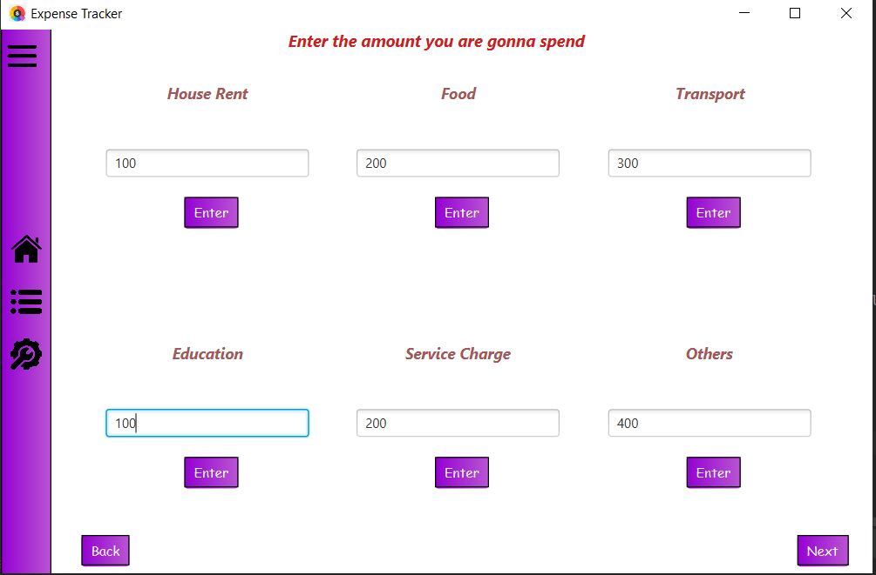
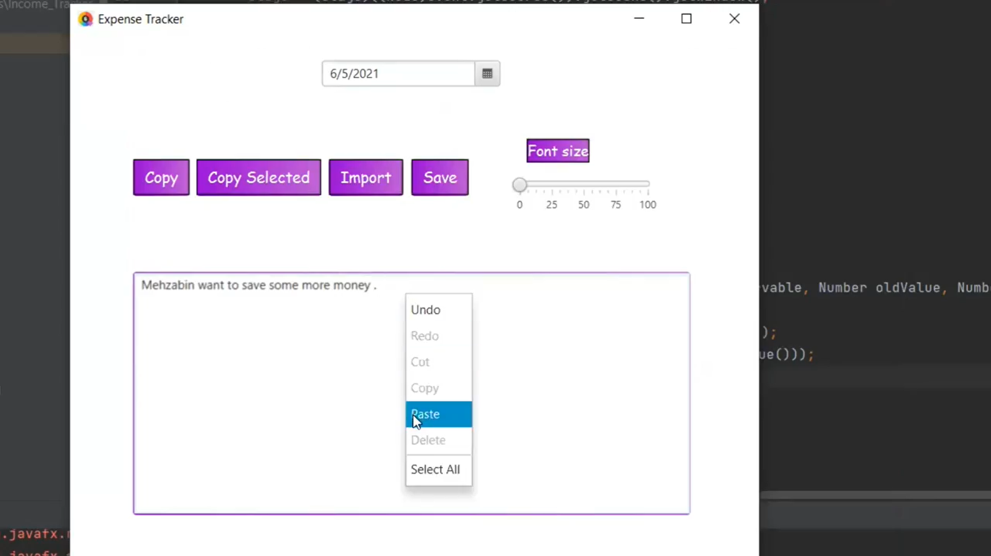
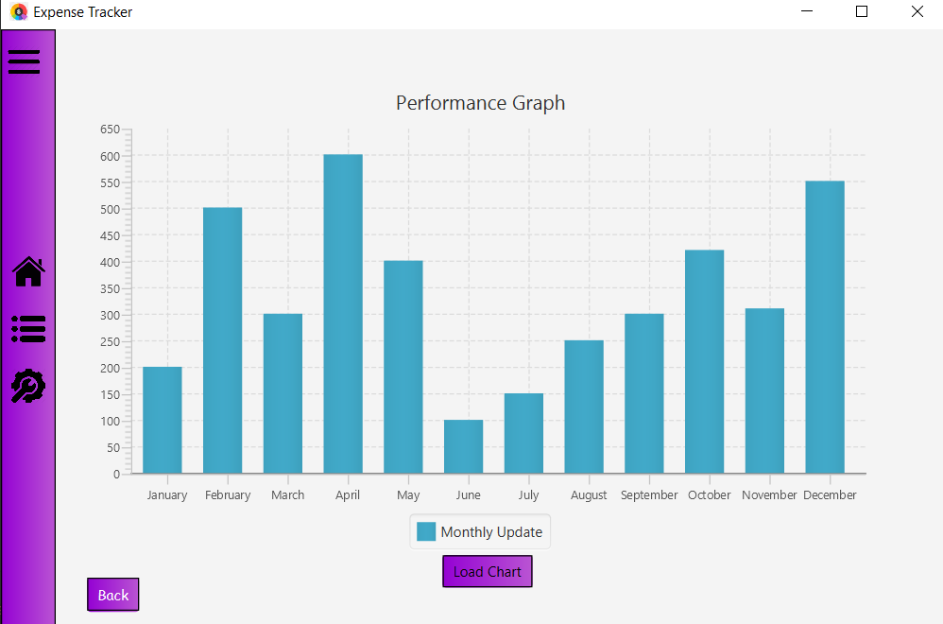
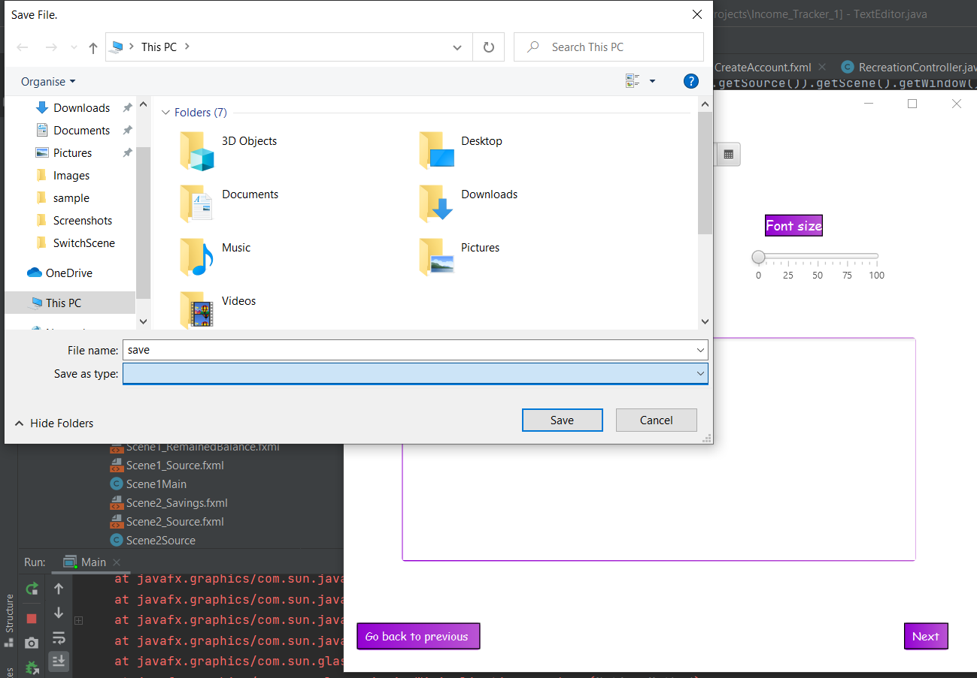
Project Details:
E
Features:
Welcome pages, registration form, sign in, income input, expense input, remaining balance show, add money for savings, add money for recreation, alert box, bar graph, line graph, text editor, buttons(enter, logout, scene switch) etc.
There is a feature of a text editor where the user will be able to pick a date and write their daily expenses according to their wish. The options of the text editor are copy text, copy selected text, import file from desktop and save file to the desktop.
X
The users can also see two type of graphs of their savings of the whole year depending on their choice
By clicking next button, there will be a page where the user will be able to input all his expenses of the month. All the entered data will be stored in a separate file.
Finally, there will be the last page thanking the user for using expense tracker and the name of the developers with a logout button at the corner. By clicking the logout button, the user will logout and the program will end.
FXML:
Tab, TabPane, Button, TextField, PasswordField, TableView, GridPane, ScrollPane, ChoiceBox, DatePicker etc.
• CSS: Codes written to import into our FXML documents for specific designs.
• Controller: Class to control the FXML files.
Then there is a welcome page with two buttons of sign up and sign in. By clicking sign up one will be able to create an account with few information . All the information will be stored in two files. After clicking register button the registration will be complete and go to next button of that page will take user to the login page. By providing correct username and password user will be able to enter the project.
Expense Tracker Everything you need to keep track of your money
P
The aim of this project is to create a user-friendly
software where user will be able to create an account, log in and then add information about their income, expenses and will browse through a wide number of features.
At first there is a page where an animated scene with the name of the project is shown.
University of Dhaka
After adding for savings, the remained money will automatically be added for recreational cost. The user will be able to enter recreational cost on a regular basis. Whenever he will have less than 1000 taka in his list, he will be notified with a warning and if he has no money left, he will be shown a message that his balance is finished.
After that there will be a page where the remained money will be shown and there will also be two options such as add money for savings and add money for recreation.
E
Submitted To:
Software Tools :
Java: The coding language (JDK 1.8)
JavaFX: The library we used to create our GUI’s. Some libraries used are: EventHandler,
FXMLLoader, ActionEvent etc.
IntelliJ: IDE for coding
Scene Builder: Third-party software for manually creating GUI layout.
STL:
javafx.swing.jar
javafx.media.jar
javafx.graphics.jar
javafx.fxml.jar
javafx.controls.jar
javafx.base.jar
javafx-swt.jar
N
S
E
Introduction:
In our everyday life, we often lose track of our day to day expenses. Thus, at the end of the month or at any emergency we end up calling our friends asking for help. Undoubtedly, this is a hassle. Our project will help the users to keep a track of their money.
Motivation:
We were assigned a java project and the three of us were thinking of making something that will be useful for our day to day life. And thus we decided to work on Expense Tracker. We used our knowledge of Java and JavaFX to complete this project.
Conclusion:
We have tried to make our project as much as like mainstream expense tracking app as possible.
Maintaining 100% accuracy was not possible; there were a few limitations, and we faced some difficulties while making the project. However, we managed to add all the features submitted to our project proposal and more. The overall working experience for this project was satisfactory.
T
Course Code : SE 206
Course Name : Object Oriented Programming
Project Title : Expense Tracker
R
After signing in, the user will get the page for putting information of all his income sources. By clicking enter button, the provided data will be stored in a separate file.
A
C
K
ER
Submitted By:
Rupali Tasnim Samad (1208 )
Sifat Sikder (1221)
Mehzabin Haque (1233)
By clicking on add button for savings, user will be able to see how much money he has left and then he can input the amount he wants to save in that month.
Here is a demonstration video of how the program works.

Slide 2
Project Details:
Features:
Welcome pages, registration form, sign in, income input, expense input, remaining balance show, add money for savings, add money for recreation, alert box, bar graph, line graph, text editor, buttons(enter, logout, scene switch) etc.
There is a feature of a text editor where the user will be able to pick a date and write their daily expenses according to their wish. The options of the text editor are copy text, copy selected text, import file from desktop and save file to the desktop.
The users can also see two type of graphs of their savings of the whole year depending on their choice
By clicking next button, there will be a page where the user will be able to input all his expenses of the month. All the entered data will be stored in a separate file.
Finally, there will be the last page thanking the user for using expense tracker and the name of the developers with a logout button at the corner. By clicking the logout button, the user will logout and the program will end.
FXML:
Tab, TabPane, Button, TextField, PasswordField, TableView, GridPane, ScrollPane, ChoiceBox, DatePicker etc.
• CSS: Codes written to import into our FXML documents for specific designs.
• Controller: Class to control the FXML files.
Then there is a welcome page with two buttons of sign up and sign in. By clicking sign up one will be able to create an account with few information . All the information will be stored in two files. After clicking register button the registration will be complete and go to next button of that page will take user to the login page. By providing correct username and password user will be able to enter the project.
Expense Tracker Everything you need to keep track of your money
Expense Tracker Everything you need to keep track of your money
The aim of this project is to create a user-friendly
software where user will be able to create an account, log in and then add information about their income, expenses and will browse through a wide number of features.
At first there is a page where an animated scene with the name of the project is shown.
After adding for savings, the remained money will automatically be added for recreational cost. The user will be able to enter recreational cost on a regular basis. Whenever he will have less than 1000 taka in his list, he will be notified with a warning and if he has no money left, he will be shown a message that his balance is finished.
After that there will be a page where the remained money will be shown and there will also be two options such as add money for savings and add money for recreation.
Software Tools :
Java: The coding language (JDK 1.8)
JavaFX: The library we used to create our GUI’s. Some libraries used are: EventHandler,
FXMLLoader, ActionEvent etc.
IntelliJ: IDE for coding
Scene Builder: Third-party software for manually creating GUI layout.
STL:
javafx.swing.jar
javafx.media.jar
javafx.graphics.jar
javafx.fxml.jar
javafx.controls.jar
javafx.base.jar
javafx-swt.jar
Introduction:
In our everyday life, we often lose track of our day to day expenses. Thus, at the end of the month or at any emergency we end up calling our friends asking for help. Undoubtedly, this is a hassle. Our project will help the users to keep a track of their money.
Motivation:
We were assigned a java project and the three of us were thinking of making something that will be useful for our day to day life. And thus we decided to work on Expense Tracker. We used our knowledge of Java and JavaFX to complete this project.
Introduction:
In our everyday life, we often lose track of our day to day expenses. Thus, at the end of the month or at any emergency we end up calling our friends asking for help. Undoubtedly, this is a hassle. Our project will help the users to keep a track of their money.
Motivation:
We were assigned a java project and the three of us were thinking of making something that will be useful for our day to day life. And thus we decided to work on Expense Tracker. We used our knowledge of Java and JavaFX to complete this project.
Conclusion:
We have tried to make our project as much as like mainstream expense tracking app as possible.
Maintaining 100% accuracy was not possible; there were a few limitations, and we faced some difficulties while making the project. However, we managed to add all the features submitted to our project proposal and more. The overall working experience for this project was satisfactory.
After signing in, the user will get the page for putting information of all his income sources. By clicking enter button, the provided data will be stored in a separate file.
By clicking on add button for savings, user will be able to see how much money he has left and then he can input the amount he wants to save in that month.
Here is a demonstration video of how the program works.

Slide 3
Project Details:
Features:
Welcome pages, registration form, sign in, income input, expense input, remaining balance show, add money for savings, add money for recreation, alert box, bar graph, line graph, text editor, buttons(enter, logout, scene switch) etc.
Project Details:
There is a feature of a text editor where the user will be able to pick a date and write their daily expenses according to their wish. The options of the text editor are copy text, copy selected text, import file from desktop and save file to the desktop.
The users can also see two type of graphs of their savings of the whole year depending on their choice
By clicking next button, there will be a page where the user will be able to input all his expenses of the month. All the entered data will be stored in a separate file.
Finally, there will be the last page thanking the user for using expense tracker and the name of the developers with a logout button at the corner. By clicking the logout button, the user will logout and the program will end.
FXML:
Tab, TabPane, Button, TextField, PasswordField, TableView, GridPane, ScrollPane, ChoiceBox, DatePicker etc.
• CSS: Codes written to import into our FXML documents for specific designs.
• Controller: Class to control the FXML files.
Then there is a welcome page with two buttons of sign up and sign in. By clicking sign up one will be able to create an account with few information . All the information will be stored in two files. After clicking register button the registration will be complete and go to next button of that page will take user to the login page. By providing correct username and password user will be able to enter the project.
Expense Tracker Everything you need to keep track of your money
The aim of this project is to create a user-friendly
software where user will be able to create an account, log in and then add information about their income, expenses and will browse through a wide number of features.
At first there is a page where an animated scene with the name of the project is shown.
The aim of this project is to create a user-friendly
software where user will be able to create an account, log in and then add information about their income, expenses and will browse through a wide number of features.
At first there is a page where an animated scene with the name of the project is shown.
After adding for savings, the remained money will automatically be added for recreational cost. The user will be able to enter recreational cost on a regular basis. Whenever he will have less than 1000 taka in his list, he will be notified with a warning and if he has no money left, he will be shown a message that his balance is finished.
After that there will be a page where the remained money will be shown and there will also be two options such as add money for savings and add money for recreation.
Software Tools :
Java: The coding language (JDK 1.8)
JavaFX: The library we used to create our GUI’s. Some libraries used are: EventHandler,
FXMLLoader, ActionEvent etc.
IntelliJ: IDE for coding
Scene Builder: Third-party software for manually creating GUI layout.
STL:
javafx.swing.jar
javafx.media.jar
javafx.graphics.jar
javafx.fxml.jar
javafx.controls.jar
javafx.base.jar
javafx-swt.jar
Introduction:
In our everyday life, we often lose track of our day to day expenses. Thus, at the end of the month or at any emergency we end up calling our friends asking for help. Undoubtedly, this is a hassle. Our project will help the users to keep a track of their money.
Motivation:
We were assigned a java project and the three of us were thinking of making something that will be useful for our day to day life. And thus we decided to work on Expense Tracker. We used our knowledge of Java and JavaFX to complete this project.
Conclusion:
We have tried to make our project as much as like mainstream expense tracking app as possible.
Maintaining 100% accuracy was not possible; there were a few limitations, and we faced some difficulties while making the project. However, we managed to add all the features submitted to our project proposal and more. The overall working experience for this project was satisfactory.
After signing in, the user will get the page for putting information of all his income sources. By clicking enter button, the provided data will be stored in a separate file.
By clicking on add button for savings, user will be able to see how much money he has left and then he can input the amount he wants to save in that month.
Here is a demonstration video of how the program works.

Slide 4
Project Details:
Features:
Welcome pages, registration form, sign in, income input, expense input, remaining balance show, add money for savings, add money for recreation, alert box, bar graph, line graph, text editor, buttons(enter, logout, scene switch) etc.
There is a feature of a text editor where the user will be able to pick a date and write their daily expenses according to their wish. The options of the text editor are copy text, copy selected text, import file from desktop and save file to the desktop.
The users can also see two type of graphs of their savings of the whole year depending on their choice
By clicking next button, there will be a page where the user will be able to input all his expenses of the month. All the entered data will be stored in a separate file.
Finally, there will be the last page thanking the user for using expense tracker and the name of the developers with a logout button at the corner. By clicking the logout button, the user will logout and the program will end.
FXML:
Tab, TabPane, Button, TextField, PasswordField, TableView, GridPane, ScrollPane, ChoiceBox, DatePicker etc.
• CSS: Codes written to import into our FXML documents for specific designs.
• Controller: Class to control the FXML files.
Then there is a welcome page with two buttons of sign up and sign in. By clicking sign up one will be able to create an account with few information . All the information will be stored in two files. After clicking register button the registration will be complete and go to next button of that page will take user to the login page. By providing correct username and password user will be able to enter the project.
Expense Tracker Everything you need to keep track of your money
Then there is a welcome page with two buttons of sign up and sign in. By clicking sign up one will be able to create an account with few information . All the information will be stored in two files. After clicking register button the registration will be complete and go to next button of that page will take user to the login page. By providing correct username and password user will be able to enter the project.
The aim of this project is to create a user-friendly
software where user will be able to create an account, log in and then add information about their income, expenses and will browse through a wide number of features.
At first there is a page where an animated scene with the name of the project is shown.
After adding for savings, the remained money will automatically be added for recreational cost. The user will be able to enter recreational cost on a regular basis. Whenever he will have less than 1000 taka in his list, he will be notified with a warning and if he has no money left, he will be shown a message that his balance is finished.
After that there will be a page where the remained money will be shown and there will also be two options such as add money for savings and add money for recreation.
Software Tools :
Java: The coding language (JDK 1.8)
JavaFX: The library we used to create our GUI’s. Some libraries used are: EventHandler,
FXMLLoader, ActionEvent etc.
IntelliJ: IDE for coding
Scene Builder: Third-party software for manually creating GUI layout.
STL:
javafx.swing.jar
javafx.media.jar
javafx.graphics.jar
javafx.fxml.jar
javafx.controls.jar
javafx.base.jar
javafx-swt.jar
Introduction:
In our everyday life, we often lose track of our day to day expenses. Thus, at the end of the month or at any emergency we end up calling our friends asking for help. Undoubtedly, this is a hassle. Our project will help the users to keep a track of their money.
Motivation:
We were assigned a java project and the three of us were thinking of making something that will be useful for our day to day life. And thus we decided to work on Expense Tracker. We used our knowledge of Java and JavaFX to complete this project.
Conclusion:
We have tried to make our project as much as like mainstream expense tracking app as possible.
Maintaining 100% accuracy was not possible; there were a few limitations, and we faced some difficulties while making the project. However, we managed to add all the features submitted to our project proposal and more. The overall working experience for this project was satisfactory.
After signing in, the user will get the page for putting information of all his income sources. By clicking enter button, the provided data will be stored in a separate file.
By clicking on add button for savings, user will be able to see how much money he has left and then he can input the amount he wants to save in that month.
Here is a demonstration video of how the program works.

Slide 5
Project Details:
Features:
Welcome pages, registration form, sign in, income input, expense input, remaining balance show, add money for savings, add money for recreation, alert box, bar graph, line graph, text editor, buttons(enter, logout, scene switch) etc.
There is a feature of a text editor where the user will be able to pick a date and write their daily expenses according to their wish. The options of the text editor are copy text, copy selected text, import file from desktop and save file to the desktop.
The users can also see two type of graphs of their savings of the whole year depending on their choice
By clicking next button, there will be a page where the user will be able to input all his expenses of the month. All the entered data will be stored in a separate file.
Finally, there will be the last page thanking the user for using expense tracker and the name of the developers with a logout button at the corner. By clicking the logout button, the user will logout and the program will end.
FXML:
Tab, TabPane, Button, TextField, PasswordField, TableView, GridPane, ScrollPane, ChoiceBox, DatePicker etc.
• CSS: Codes written to import into our FXML documents for specific designs.
• Controller: Class to control the FXML files.
Then there is a welcome page with two buttons of sign up and sign in. By clicking sign up one will be able to create an account with few information . All the information will be stored in two files. After clicking register button the registration will be complete and go to next button of that page will take user to the login page. By providing correct username and password user will be able to enter the project.
Expense Tracker Everything you need to keep track of your money
The aim of this project is to create a user-friendly
software where user will be able to create an account, log in and then add information about their income, expenses and will browse through a wide number of features.
At first there is a page where an animated scene with the name of the project is shown.
After adding for savings, the remained money will automatically be added for recreational cost. The user will be able to enter recreational cost on a regular basis. Whenever he will have less than 1000 taka in his list, he will be notified with a warning and if he has no money left, he will be shown a message that his balance is finished.
After that there will be a page where the remained money will be shown and there will also be two options such as add money for savings and add money for recreation.
Software Tools :
Java: The coding language (JDK 1.8)
JavaFX: The library we used to create our GUI’s. Some libraries used are: EventHandler,
FXMLLoader, ActionEvent etc.
IntelliJ: IDE for coding
Scene Builder: Third-party software for manually creating GUI layout.
STL:
javafx.swing.jar
javafx.media.jar
javafx.graphics.jar
javafx.fxml.jar
javafx.controls.jar
javafx.base.jar
javafx-swt.jar
Introduction:
In our everyday life, we often lose track of our day to day expenses. Thus, at the end of the month or at any emergency we end up calling our friends asking for help. Undoubtedly, this is a hassle. Our project will help the users to keep a track of their money.
Motivation:
We were assigned a java project and the three of us were thinking of making something that will be useful for our day to day life. And thus we decided to work on Expense Tracker. We used our knowledge of Java and JavaFX to complete this project.
Conclusion:
We have tried to make our project as much as like mainstream expense tracking app as possible.
Maintaining 100% accuracy was not possible; there were a few limitations, and we faced some difficulties while making the project. However, we managed to add all the features submitted to our project proposal and more. The overall working experience for this project was satisfactory.
After signing in, the user will get the page for putting information of all his income sources. By clicking enter button, the provided data will be stored in a separate file.
After signing in, the user will get the page for putting information of all his income sources. By clicking enter button, the provided data will be stored in a separate file.
By clicking on add button for savings, user will be able to see how much money he has left and then he can input the amount he wants to save in that month.
Here is a demonstration video of how the program works.

Slide 6
Project Details:
Features:
Welcome pages, registration form, sign in, income input, expense input, remaining balance show, add money for savings, add money for recreation, alert box, bar graph, line graph, text editor, buttons(enter, logout, scene switch) etc.
There is a feature of a text editor where the user will be able to pick a date and write their daily expenses according to their wish. The options of the text editor are copy text, copy selected text, import file from desktop and save file to the desktop.
The users can also see two type of graphs of their savings of the whole year depending on their choice
By clicking next button, there will be a page where the user will be able to input all his expenses of the month. All the entered data will be stored in a separate file.
By clicking next button, there will be a page where the user will be able to input all his expenses of the month. All the entered data will be stored in a separate file.
Finally, there will be the last page thanking the user for using expense tracker and the name of the developers with a logout button at the corner. By clicking the logout button, the user will logout and the program will end.
FXML:
Tab, TabPane, Button, TextField, PasswordField, TableView, GridPane, ScrollPane, ChoiceBox, DatePicker etc.
• CSS: Codes written to import into our FXML documents for specific designs.
• Controller: Class to control the FXML files.
Then there is a welcome page with two buttons of sign up and sign in. By clicking sign up one will be able to create an account with few information . All the information will be stored in two files. After clicking register button the registration will be complete and go to next button of that page will take user to the login page. By providing correct username and password user will be able to enter the project.
Expense Tracker Everything you need to keep track of your money
The aim of this project is to create a user-friendly
software where user will be able to create an account, log in and then add information about their income, expenses and will browse through a wide number of features.
At first there is a page where an animated scene with the name of the project is shown.
After adding for savings, the remained money will automatically be added for recreational cost. The user will be able to enter recreational cost on a regular basis. Whenever he will have less than 1000 taka in his list, he will be notified with a warning and if he has no money left, he will be shown a message that his balance is finished.
After that there will be a page where the remained money will be shown and there will also be two options such as add money for savings and add money for recreation.
After that there will be a page where the remained money will be shown and there will also be two options such as add money for savings and add money for recreation.
Software Tools :
Java: The coding language (JDK 1.8)
JavaFX: The library we used to create our GUI’s. Some libraries used are: EventHandler,
FXMLLoader, ActionEvent etc.
IntelliJ: IDE for coding
Scene Builder: Third-party software for manually creating GUI layout.
STL:
javafx.swing.jar
javafx.media.jar
javafx.graphics.jar
javafx.fxml.jar
javafx.controls.jar
javafx.base.jar
javafx-swt.jar
Introduction:
In our everyday life, we often lose track of our day to day expenses. Thus, at the end of the month or at any emergency we end up calling our friends asking for help. Undoubtedly, this is a hassle. Our project will help the users to keep a track of their money.
Motivation:
We were assigned a java project and the three of us were thinking of making something that will be useful for our day to day life. And thus we decided to work on Expense Tracker. We used our knowledge of Java and JavaFX to complete this project.
Conclusion:
We have tried to make our project as much as like mainstream expense tracking app as possible.
Maintaining 100% accuracy was not possible; there were a few limitations, and we faced some difficulties while making the project. However, we managed to add all the features submitted to our project proposal and more. The overall working experience for this project was satisfactory.
After signing in, the user will get the page for putting information of all his income sources. By clicking enter button, the provided data will be stored in a separate file.
By clicking on add button for savings, user will be able to see how much money he has left and then he can input the amount he wants to save in that month.
By clicking on add button for savings, user will be able to see how much money he has left and then he can input the amount he wants to save in that month.
Here is a demonstration video of how the program works.

Slide 7
Project Details:
Features:
Welcome pages, registration form, sign in, income input, expense input, remaining balance show, add money for savings, add money for recreation, alert box, bar graph, line graph, text editor, buttons(enter, logout, scene switch) etc.
There is a feature of a text editor where the user will be able to pick a date and write their daily expenses according to their wish. The options of the text editor are copy text, copy selected text, import file from desktop and save file to the desktop.
The users can also see two type of graphs of their savings of the whole year depending on their choice
By clicking next button, there will be a page where the user will be able to input all his expenses of the month. All the entered data will be stored in a separate file.
Finally, there will be the last page thanking the user for using expense tracker and the name of the developers with a logout button at the corner. By clicking the logout button, the user will logout and the program will end.
FXML:
Tab, TabPane, Button, TextField, PasswordField, TableView, GridPane, ScrollPane, ChoiceBox, DatePicker etc.
• CSS: Codes written to import into our FXML documents for specific designs.
• Controller: Class to control the FXML files.
Then there is a welcome page with two buttons of sign up and sign in. By clicking sign up one will be able to create an account with few information . All the information will be stored in two files. After clicking register button the registration will be complete and go to next button of that page will take user to the login page. By providing correct username and password user will be able to enter the project.
Expense Tracker Everything you need to keep track of your money
The aim of this project is to create a user-friendly
software where user will be able to create an account, log in and then add information about their income, expenses and will browse through a wide number of features.
At first there is a page where an animated scene with the name of the project is shown.
After adding for savings, the remained money will automatically be added for recreational cost. The user will be able to enter recreational cost on a regular basis. Whenever he will have less than 1000 taka in his list, he will be notified with a warning and if he has no money left, he will be shown a message that his balance is finished.
After adding for savings, the remained money will automatically be added for recreational cost. The user will be able to enter recreational cost on a regular basis. Whenever he will have less than 1000 taka in his list, he will be notified with a warning and if he has no money left, he will be shown a message that his balance is finished.
After that there will be a page where the remained money will be shown and there will also be two options such as add money for savings and add money for recreation.
Software Tools :
Java: The coding language (JDK 1.8)
JavaFX: The library we used to create our GUI’s. Some libraries used are: EventHandler,
FXMLLoader, ActionEvent etc.
IntelliJ: IDE for coding
Scene Builder: Third-party software for manually creating GUI layout.
STL:
javafx.swing.jar
javafx.media.jar
javafx.graphics.jar
javafx.fxml.jar
javafx.controls.jar
javafx.base.jar
javafx-swt.jar
Introduction:
In our everyday life, we often lose track of our day to day expenses. Thus, at the end of the month or at any emergency we end up calling our friends asking for help. Undoubtedly, this is a hassle. Our project will help the users to keep a track of their money.
Motivation:
We were assigned a java project and the three of us were thinking of making something that will be useful for our day to day life. And thus we decided to work on Expense Tracker. We used our knowledge of Java and JavaFX to complete this project.
Conclusion:
We have tried to make our project as much as like mainstream expense tracking app as possible.
Maintaining 100% accuracy was not possible; there were a few limitations, and we faced some difficulties while making the project. However, we managed to add all the features submitted to our project proposal and more. The overall working experience for this project was satisfactory.
After signing in, the user will get the page for putting information of all his income sources. By clicking enter button, the provided data will be stored in a separate file.
By clicking on add button for savings, user will be able to see how much money he has left and then he can input the amount he wants to save in that month.
Here is a demonstration video of how the program works.

Slide 8
Project Details:
Features:
Welcome pages, registration form, sign in, income input, expense input, remaining balance show, add money for savings, add money for recreation, alert box, bar graph, line graph, text editor, buttons(enter, logout, scene switch) etc.
There is a feature of a text editor where the user will be able to pick a date and write their daily expenses according to their wish. The options of the text editor are copy text, copy selected text, import file from desktop and save file to the desktop.
The users can also see two type of graphs of their savings of the whole year depending on their choice
By clicking next button, there will be a page where the user will be able to input all his expenses of the month. All the entered data will be stored in a separate file.
Finally, there will be the last page thanking the user for using expense tracker and the name of the developers with a logout button at the corner. By clicking the logout button, the user will logout and the program will end.
FXML:
Tab, TabPane, Button, TextField, PasswordField, TableView, GridPane, ScrollPane, ChoiceBox, DatePicker etc.
• CSS: Codes written to import into our FXML documents for specific designs.
• Controller: Class to control the FXML files.
Then there is a welcome page with two buttons of sign up and sign in. By clicking sign up one will be able to create an account with few information . All the information will be stored in two files. After clicking register button the registration will be complete and go to next button of that page will take user to the login page. By providing correct username and password user will be able to enter the project.
The users can also see two type of graphs of their savings of the whole year depending on their choice
Expense Tracker Everything you need to keep track of your money
The aim of this project is to create a user-friendly
software where user will be able to create an account, log in and then add information about their income, expenses and will browse through a wide number of features.
At first there is a page where an animated scene with the name of the project is shown.
After adding for savings, the remained money will automatically be added for recreational cost. The user will be able to enter recreational cost on a regular basis. Whenever he will have less than 1000 taka in his list, he will be notified with a warning and if he has no money left, he will be shown a message that his balance is finished.
After that there will be a page where the remained money will be shown and there will also be two options such as add money for savings and add money for recreation.
Software Tools :
Java: The coding language (JDK 1.8)
JavaFX: The library we used to create our GUI’s. Some libraries used are: EventHandler,
FXMLLoader, ActionEvent etc.
IntelliJ: IDE for coding
Scene Builder: Third-party software for manually creating GUI layout.
STL:
javafx.swing.jar
javafx.media.jar
javafx.graphics.jar
javafx.fxml.jar
javafx.controls.jar
javafx.base.jar
javafx-swt.jar
Introduction:
In our everyday life, we often lose track of our day to day expenses. Thus, at the end of the month or at any emergency we end up calling our friends asking for help. Undoubtedly, this is a hassle. Our project will help the users to keep a track of their money.
Motivation:
We were assigned a java project and the three of us were thinking of making something that will be useful for our day to day life. And thus we decided to work on Expense Tracker. We used our knowledge of Java and JavaFX to complete this project.
Conclusion:
We have tried to make our project as much as like mainstream expense tracking app as possible.
Maintaining 100% accuracy was not possible; there were a few limitations, and we faced some difficulties while making the project. However, we managed to add all the features submitted to our project proposal and more. The overall working experience for this project was satisfactory.
After signing in, the user will get the page for putting information of all his income sources. By clicking enter button, the provided data will be stored in a separate file.
By clicking on add button for savings, user will be able to see how much money he has left and then he can input the amount he wants to save in that month.
Here is a demonstration video of how the program works.

Slide 9
Project Details:
Features:
Welcome pages, registration form, sign in, income input, expense input, remaining balance show, add money for savings, add money for recreation, alert box, bar graph, line graph, text editor, buttons(enter, logout, scene switch) etc.
There is a feature of a text editor where the user will be able to pick a date and write their daily expenses according to their wish. The options of the text editor are copy text, copy selected text, import file from desktop and save file to the desktop.
There is a feature of a text editor where the user will be able to pick a date and write their daily expenses according to their wish. The options of the text editor are copy text, copy selected text, import file from desktop and save file to the desktop.
The users can also see two type of graphs of their savings of the whole year depending on their choice
By clicking next button, there will be a page where the user will be able to input all his expenses of the month. All the entered data will be stored in a separate file.
Finally, there will be the last page thanking the user for using expense tracker and the name of the developers with a logout button at the corner. By clicking the logout button, the user will logout and the program will end.
FXML:
Tab, TabPane, Button, TextField, PasswordField, TableView, GridPane, ScrollPane, ChoiceBox, DatePicker etc.
• CSS: Codes written to import into our FXML documents for specific designs.
• Controller: Class to control the FXML files.
Then there is a welcome page with two buttons of sign up and sign in. By clicking sign up one will be able to create an account with few information . All the information will be stored in two files. After clicking register button the registration will be complete and go to next button of that page will take user to the login page. By providing correct username and password user will be able to enter the project.
Expense Tracker Everything you need to keep track of your money
The aim of this project is to create a user-friendly
software where user will be able to create an account, log in and then add information about their income, expenses and will browse through a wide number of features.
At first there is a page where an animated scene with the name of the project is shown.
After adding for savings, the remained money will automatically be added for recreational cost. The user will be able to enter recreational cost on a regular basis. Whenever he will have less than 1000 taka in his list, he will be notified with a warning and if he has no money left, he will be shown a message that his balance is finished.
After that there will be a page where the remained money will be shown and there will also be two options such as add money for savings and add money for recreation.
Software Tools :
Java: The coding language (JDK 1.8)
JavaFX: The library we used to create our GUI’s. Some libraries used are: EventHandler,
FXMLLoader, ActionEvent etc.
IntelliJ: IDE for coding
Scene Builder: Third-party software for manually creating GUI layout.
STL:
javafx.swing.jar
javafx.media.jar
javafx.graphics.jar
javafx.fxml.jar
javafx.controls.jar
javafx.base.jar
javafx-swt.jar
Introduction:
In our everyday life, we often lose track of our day to day expenses. Thus, at the end of the month or at any emergency we end up calling our friends asking for help. Undoubtedly, this is a hassle. Our project will help the users to keep a track of their money.
Motivation:
We were assigned a java project and the three of us were thinking of making something that will be useful for our day to day life. And thus we decided to work on Expense Tracker. We used our knowledge of Java and JavaFX to complete this project.
Conclusion:
We have tried to make our project as much as like mainstream expense tracking app as possible.
Maintaining 100% accuracy was not possible; there were a few limitations, and we faced some difficulties while making the project. However, we managed to add all the features submitted to our project proposal and more. The overall working experience for this project was satisfactory.
After signing in, the user will get the page for putting information of all his income sources. By clicking enter button, the provided data will be stored in a separate file.
By clicking on add button for savings, user will be able to see how much money he has left and then he can input the amount he wants to save in that month.
Here is a demonstration video of how the program works.

Slide 10
Project Details:
Features:
Welcome pages, registration form, sign in, income input, expense input, remaining balance show, add money for savings, add money for recreation, alert box, bar graph, line graph, text editor, buttons(enter, logout, scene switch) etc.
There is a feature of a text editor where the user will be able to pick a date and write their daily expenses according to their wish. The options of the text editor are copy text, copy selected text, import file from desktop and save file to the desktop.
The users can also see two type of graphs of their savings of the whole year depending on their choice
By clicking next button, there will be a page where the user will be able to input all his expenses of the month. All the entered data will be stored in a separate file.
Finally, there will be the last page thanking the user for using expense tracker and the name of the developers with a logout button at the corner. By clicking the logout button, the user will logout and the program will end.
FXML:
Tab, TabPane, Button, TextField, PasswordField, TableView, GridPane, ScrollPane, ChoiceBox, DatePicker etc.
• CSS: Codes written to import into our FXML documents for specific designs.
• Controller: Class to control the FXML files.
Then there is a welcome page with two buttons of sign up and sign in. By clicking sign up one will be able to create an account with few information . All the information will be stored in two files. After clicking register button the registration will be complete and go to next button of that page will take user to the login page. By providing correct username and password user will be able to enter the project.
Expense Tracker Everything you need to keep track of your money
Finally, there will be the last page thanking the user for using expense tracker and the name of the developers with a logout button at the corner. By clicking the logout button, the user will logout and the program will end.
The aim of this project is to create a user-friendly
software where user will be able to create an account, log in and then add information about their income, expenses and will browse through a wide number of features.
At first there is a page where an animated scene with the name of the project is shown.
After adding for savings, the remained money will automatically be added for recreational cost. The user will be able to enter recreational cost on a regular basis. Whenever he will have less than 1000 taka in his list, he will be notified with a warning and if he has no money left, he will be shown a message that his balance is finished.
After that there will be a page where the remained money will be shown and there will also be two options such as add money for savings and add money for recreation.
Software Tools :
Java: The coding language (JDK 1.8)
JavaFX: The library we used to create our GUI’s. Some libraries used are: EventHandler,
FXMLLoader, ActionEvent etc.
IntelliJ: IDE for coding
Scene Builder: Third-party software for manually creating GUI layout.
STL:
javafx.swing.jar
javafx.media.jar
javafx.graphics.jar
javafx.fxml.jar
javafx.controls.jar
javafx.base.jar
javafx-swt.jar
Introduction:
In our everyday life, we often lose track of our day to day expenses. Thus, at the end of the month or at any emergency we end up calling our friends asking for help. Undoubtedly, this is a hassle. Our project will help the users to keep a track of their money.
Motivation:
We were assigned a java project and the three of us were thinking of making something that will be useful for our day to day life. And thus we decided to work on Expense Tracker. We used our knowledge of Java and JavaFX to complete this project.
Conclusion:
We have tried to make our project as much as like mainstream expense tracking app as possible.
Maintaining 100% accuracy was not possible; there were a few limitations, and we faced some difficulties while making the project. However, we managed to add all the features submitted to our project proposal and more. The overall working experience for this project was satisfactory.
After signing in, the user will get the page for putting information of all his income sources. By clicking enter button, the provided data will be stored in a separate file.
By clicking on add button for savings, user will be able to see how much money he has left and then he can input the amount he wants to save in that month.
Here is a demonstration video of how the program works.

Slide 11
Project Details:
Features:
Welcome pages, registration form, sign in, income input, expense input, remaining balance show, add money for savings, add money for recreation, alert box, bar graph, line graph, text editor, buttons(enter, logout, scene switch) etc.
There is a feature of a text editor where the user will be able to pick a date and write their daily expenses according to their wish. The options of the text editor are copy text, copy selected text, import file from desktop and save file to the desktop.
The users can also see two type of graphs of their savings of the whole year depending on their choice
By clicking next button, there will be a page where the user will be able to input all his expenses of the month. All the entered data will be stored in a separate file.
Finally, there will be the last page thanking the user for using expense tracker and the name of the developers with a logout button at the corner. By clicking the logout button, the user will logout and the program will end.
FXML:
Tab, TabPane, Button, TextField, PasswordField, TableView, GridPane, ScrollPane, ChoiceBox, DatePicker etc.
• CSS: Codes written to import into our FXML documents for specific designs.
• Controller: Class to control the FXML files.
Then there is a welcome page with two buttons of sign up and sign in. By clicking sign up one will be able to create an account with few information . All the information will be stored in two files. After clicking register button the registration will be complete and go to next button of that page will take user to the login page. By providing correct username and password user will be able to enter the project.
Expense Tracker Everything you need to keep track of your money
The aim of this project is to create a user-friendly
software where user will be able to create an account, log in and then add information about their income, expenses and will browse through a wide number of features.
At first there is a page where an animated scene with the name of the project is shown.
Here is the demonstration video of how the tracker works.
After adding for savings, the remained money will automatically be added for recreational cost. The user will be able to enter recreational cost on a regular basis. Whenever he will have less than 1000 taka in his list, he will be notified with a warning and if he has no money left, he will be shown a message that his balance is finished.
After that there will be a page where the remained money will be shown and there will also be two options such as add money for savings and add money for recreation.
Software Tools :
Java: The coding language (JDK 1.8)
JavaFX: The library we used to create our GUI’s. Some libraries used are: EventHandler,
FXMLLoader, ActionEvent etc.
IntelliJ: IDE for coding
Scene Builder: Third-party software for manually creating GUI layout.
STL:
javafx.swing.jar
javafx.media.jar
javafx.graphics.jar
javafx.fxml.jar
javafx.controls.jar
javafx.base.jar
javafx-swt.jar
Introduction:
In our everyday life, we often lose track of our day to day expenses. Thus, at the end of the month or at any emergency we end up calling our friends asking for help. Undoubtedly, this is a hassle. Our project will help the users to keep a track of their money.
Motivation:
We were assigned a java project and the three of us were thinking of making something that will be useful for our day to day life. And thus we decided to work on Expense Tracker. We used our knowledge of Java and JavaFX to complete this project.
Conclusion:
We have tried to make our project as much as like mainstream expense tracking app as possible.
Maintaining 100% accuracy was not possible; there were a few limitations, and we faced some difficulties while making the project. However, we managed to add all the features submitted to our project proposal and more. The overall working experience for this project was satisfactory.
After signing in, the user will get the page for putting information of all his income sources. By clicking enter button, the provided data will be stored in a separate file.
By clicking on add button for savings, user will be able to see how much money he has left and then he can input the amount he wants to save in that month.
Here is a demonstration video of how the program works.

Slide 12
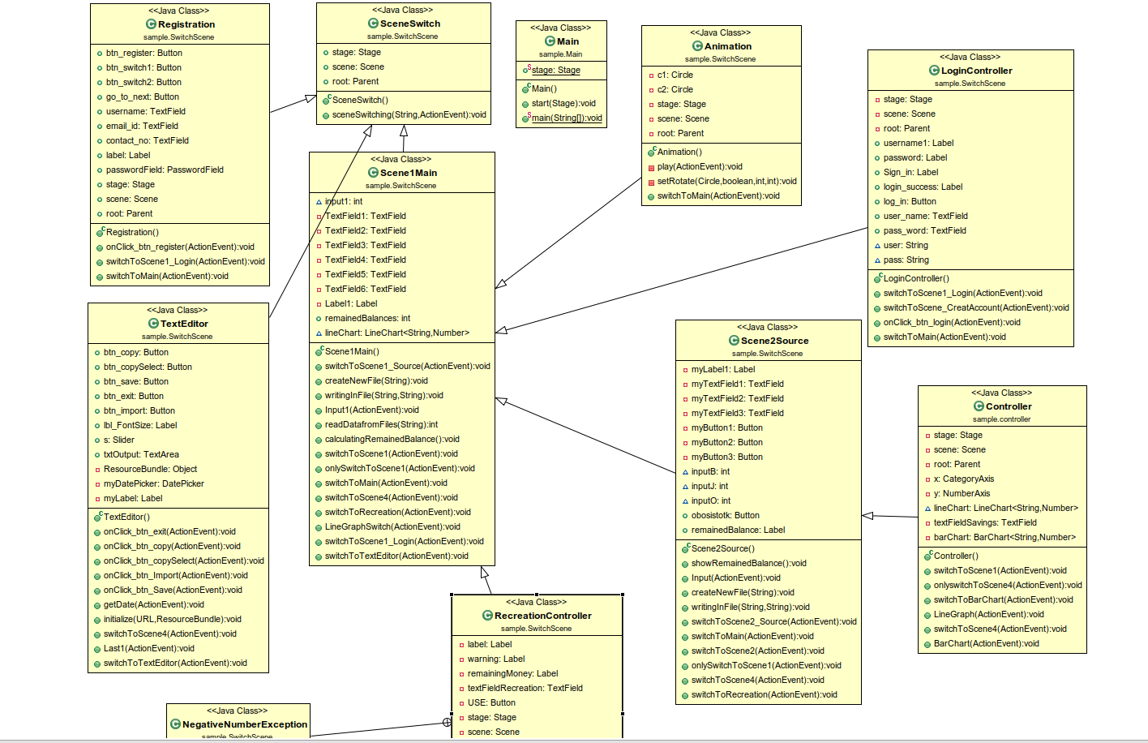
Project Details:
Features:
Welcome pages, registration form, sign in, income input, expense input, remaining balance show, add money for savings, add money for recreation, alert box, bar graph, line graph, text editor, buttons(enter, logout, scene switch) etc.
UML DIAGRAM
There is a feature of a text editor where the user will be able to pick a date and write their daily expenses according to their wish. The options of the text editor are copy text, copy selected text, import file from desktop and save file to the desktop.
The users can also see two type of graphs of their savings of the whole year depending on their choice
By clicking next button, there will be a page where the user will be able to input all his expenses of the month. All the entered data will be stored in a separate file.
Finally, there will be the last page thanking the user for using expense tracker and the name of the developers with a logout button at the corner. By clicking the logout button, the user will logout and the program will end.
FXML:
Tab, TabPane, Button, TextField, PasswordField, TableView, GridPane, ScrollPane, ChoiceBox, DatePicker etc.
• CSS: Codes written to import into our FXML documents for specific designs.
• Controller: Class to control the FXML files.
Then there is a welcome page with two buttons of sign up and sign in. By clicking sign up one will be able to create an account with few information . All the information will be stored in two files. After clicking register button the registration will be complete and go to next button of that page will take user to the login page. By providing correct username and password user will be able to enter the project.
Expense Tracker Everything you need to keep track of your money
The aim of this project is to create a user-friendly
software where user will be able to create an account, log in and then add information about their income, expenses and will browse through a wide number of features.
At first there is a page where an animated scene with the name of the project is shown.
After adding for savings, the remained money will automatically be added for recreational cost. The user will be able to enter recreational cost on a regular basis. Whenever he will have less than 1000 taka in his list, he will be notified with a warning and if he has no money left, he will be shown a message that his balance is finished.
After that there will be a page where the remained money will be shown and there will also be two options such as add money for savings and add money for recreation.
Software Tools :
Java: The coding language (JDK 1.8)
JavaFX: The library we used to create our GUI’s. Some libraries used are: EventHandler,
FXMLLoader, ActionEvent etc.
IntelliJ: IDE for coding
Scene Builder: Third-party software for manually creating GUI layout.
STL:
javafx.swing.jar
javafx.media.jar
javafx.graphics.jar
javafx.fxml.jar
javafx.controls.jar
javafx.base.jar
javafx-swt.jar
Introduction:
In our everyday life, we often lose track of our day to day expenses. Thus, at the end of the month or at any emergency we end up calling our friends asking for help. Undoubtedly, this is a hassle. Our project will help the users to keep a track of their money.
Motivation:
We were assigned a java project and the three of us were thinking of making something that will be useful for our day to day life. And thus we decided to work on Expense Tracker. We used our knowledge of Java and JavaFX to complete this project.
Conclusion:
We have tried to make our project as much as like mainstream expense tracking app as possible.
Maintaining 100% accuracy was not possible; there were a few limitations, and we faced some difficulties while making the project. However, we managed to add all the features submitted to our project proposal and more. The overall working experience for this project was satisfactory.
After signing in, the user will get the page for putting information of all his income sources. By clicking enter button, the provided data will be stored in a separate file.
By clicking on add button for savings, user will be able to see how much money he has left and then he can input the amount he wants to save in that month.
Here is a demonstration video of how the program works.

Slide 13
Project Details:
Features:
Welcome pages, registration form, sign in, income input, expense input, remaining balance show, add money for savings, add money for recreation, alert box, bar graph, line graph, text editor, buttons(enter, logout, scene switch) etc.
There is a feature of a text editor where the user will be able to pick a date and write their daily expenses according to their wish. The options of the text editor are copy text, copy selected text, import file from desktop and save file to the desktop.
OOP concepts used:
Class, object, constructor, inheritance, encapsulation, interface, abstraction, generics, exception handling, file I/O, method overrding.
The users can also see two type of graphs of their savings of the whole year depending on their choice
By clicking next button, there will be a page where the user will be able to input all his expenses of the month. All the entered data will be stored in a separate file.
Finally, there will be the last page thanking the user for using expense tracker and the name of the developers with a logout button at the corner. By clicking the logout button, the user will logout and the program will end.
FXML:
Tab, TabPane, Button, TextField, PasswordField, TableView, GridPane, ScrollPane, ChoiceBox, DatePicker etc.
• CSS: Codes written to import into our FXML documents for specific designs.
• Controller: Class to control the FXML files.
Then there is a welcome page with two buttons of sign up and sign in. By clicking sign up one will be able to create an account with few information . All the information will be stored in two files. After clicking register button the registration will be complete and go to next button of that page will take user to the login page. By providing correct username and password user will be able to enter the project.
Expense Tracker Everything you need to keep track of your money
The aim of this project is to create a user-friendly
software where user will be able to create an account, log in and then add information about their income, expenses and will browse through a wide number of features.
At first there is a page where an animated scene with the name of the project is shown.
After adding for savings, the remained money will automatically be added for recreational cost. The user will be able to enter recreational cost on a regular basis. Whenever he will have less than 1000 taka in his list, he will be notified with a warning and if he has no money left, he will be shown a message that his balance is finished.
After that there will be a page where the remained money will be shown and there will also be two options such as add money for savings and add money for recreation.
Software Tools :
Java: The coding language (JDK 1.8)
JavaFX: The library we used to create our GUI’s. Some libraries used are: EventHandler,
FXMLLoader, ActionEvent etc.
IntelliJ: IDE for coding
Scene Builder: Third-party software for manually creating GUI layout.
STL:
javafx.swing.jar
javafx.media.jar
javafx.graphics.jar
javafx.fxml.jar
javafx.controls.jar
javafx.base.jar
javafx-swt.jar
Software Tools :
Java: The coding language (JDK 1.8)
JavaFX: The library we used to create our GUI’s. Some libraries used are: EventHandler,
FXMLLoader, ActionEvent etc.
IntelliJ: IDE for coding
Scene Builder: Third-party software for manually creating GUI layout.
STL:
javafx.swing.jar
javafx.media.jar
javafx.graphics.jar
javafx.fxml.jar
javafx.controls.jar
javafx.base.jar
javafx-swt.jar
Introduction:
In our everyday life, we often lose track of our day to day expenses. Thus, at the end of the month or at any emergency we end up calling our friends asking for help. Undoubtedly, this is a hassle. Our project will help the users to keep a track of their money.
Motivation:
We were assigned a java project and the three of us were thinking of making something that will be useful for our day to day life. And thus we decided to work on Expense Tracker. We used our knowledge of Java and JavaFX to complete this project.
Conclusion:
We have tried to make our project as much as like mainstream expense tracking app as possible.
Maintaining 100% accuracy was not possible; there were a few limitations, and we faced some difficulties while making the project. However, we managed to add all the features submitted to our project proposal and more. The overall working experience for this project was satisfactory.
After signing in, the user will get the page for putting information of all his income sources. By clicking enter button, the provided data will be stored in a separate file.
By clicking on add button for savings, user will be able to see how much money he has left and then he can input the amount he wants to save in that month.
Here is a demonstration video of how the program works.

Slide 14
Project Details:
Features:
Welcome pages, registration form, sign in, income input, expense input, remaining balance show, add money for savings, add money for recreation, alert box, bar graph, line graph, text editor, buttons(enter, logout, scene switch) etc.
There is a feature of a text editor where the user will be able to pick a date and write their daily expenses according to their wish. The options of the text editor are copy text, copy selected text, import file from desktop and save file to the desktop.
The users can also see two type of graphs of their savings of the whole year depending on their choice
By clicking next button, there will be a page where the user will be able to input all his expenses of the month. All the entered data will be stored in a separate file.
Finally, there will be the last page thanking the user for using expense tracker and the name of the developers with a logout button at the corner. By clicking the logout button, the user will logout and the program will end.
FXML:
Tab, TabPane, Button, TextField, PasswordField, TableView, GridPane, ScrollPane, ChoiceBox, DatePicker etc.
• CSS: Codes written to import into our FXML documents for specific designs.
• Controller: Class to control the FXML files.
Then there is a welcome page with two buttons of sign up and sign in. By clicking sign up one will be able to create an account with few information . All the information will be stored in two files. After clicking register button the registration will be complete and go to next button of that page will take user to the login page. By providing correct username and password user will be able to enter the project.
Expense Tracker Everything you need to keep track of your money
FXML:
Tab, TabPane, Button, TextField, PasswordField, TableView, GridPane, ScrollPane, ChoiceBox, DatePicker etc.
• CSS: Codes written to import into our FXML documents for specific designs.
• Controller: Class to control the FXML files.
The aim of this project is to create a user-friendly
software where user will be able to create an account, log in and then add information about their income, expenses and will browse through a wide number of features.
At first there is a page where an animated scene with the name of the project is shown.
After adding for savings, the remained money will automatically be added for recreational cost. The user will be able to enter recreational cost on a regular basis. Whenever he will have less than 1000 taka in his list, he will be notified with a warning and if he has no money left, he will be shown a message that his balance is finished.
After that there will be a page where the remained money will be shown and there will also be two options such as add money for savings and add money for recreation.
Software Tools :
Java: The coding language (JDK 1.8)
JavaFX: The library we used to create our GUI’s. Some libraries used are: EventHandler,
FXMLLoader, ActionEvent etc.
IntelliJ: IDE for coding
Scene Builder: Third-party software for manually creating GUI layout.
STL:
javafx.swing.jar
javafx.media.jar
javafx.graphics.jar
javafx.fxml.jar
javafx.controls.jar
javafx.base.jar
javafx-swt.jar
Introduction:
In our everyday life, we often lose track of our day to day expenses. Thus, at the end of the month or at any emergency we end up calling our friends asking for help. Undoubtedly, this is a hassle. Our project will help the users to keep a track of their money.
Motivation:
We were assigned a java project and the three of us were thinking of making something that will be useful for our day to day life. And thus we decided to work on Expense Tracker. We used our knowledge of Java and JavaFX to complete this project.
Conclusion:
We have tried to make our project as much as like mainstream expense tracking app as possible.
Maintaining 100% accuracy was not possible; there were a few limitations, and we faced some difficulties while making the project. However, we managed to add all the features submitted to our project proposal and more. The overall working experience for this project was satisfactory.
Conclusion:
We have tried to make our project as much as like mainstream expense tracking app as possible.
Maintaining 100% accuracy was not possible; there were a few limitations, and we faced some difficulties while making the project. However, we managed to add all the features submitted to our project proposal and more. The overall working experience for this project was satisfactory.
After signing in, the user will get the page for putting information of all his income sources. By clicking enter button, the provided data will be stored in a separate file.
By clicking on add button for savings, user will be able to see how much money he has left and then he can input the amount he wants to save in that month.
Here is a demonstration video of how the program works.

Slide 15
Project Details:
E
Features:
Welcome pages, registration form, sign in, income input, expense input, remaining balance show, add money for savings, add money for recreation, alert box, bar graph, line graph, text editor, buttons(enter, logout, scene switch) etc.
There is a feature of a text editor where the user will be able to pick a date and write their daily expenses according to their wish. The options of the text editor are copy text, copy selected text, import file from desktop and save file to the desktop.
The users can also see two type of graphs of their savings of the whole year depending on their choice
By clicking next button, there will be a page where the user will be able to input all his expenses of the month. All the entered data will be stored in a separate file.
Finally, there will be the last page thanking the user for using expense tracker and the name of the developers with a logout button at the corner. By clicking the logout button, the user will logout and the program will end.
FXML:
Tab, TabPane, Button, TextField, PasswordField, TableView, GridPane, ScrollPane, ChoiceBox, DatePicker etc.
• CSS: Codes written to import into our FXML documents for specific designs.
• Controller: Class to control the FXML files.
X
Then there is a welcome page with two buttons of sign up and sign in. By clicking sign up one will be able to create an account with few information . All the information will be stored in two files. After clicking register button the registration will be complete and go to next button of that page will take user to the login page. By providing correct username and password user will be able to enter the project.
Expense Tracker Everything you need to keep track of your money
P
The aim of this project is to create a user-friendly
software where user will be able to create an account, log in and then add information about their income, expenses and will browse through a wide number of features.
At first there is a page where an animated scene with the name of the project is shown.
After adding for savings, the remained money will automatically be added for recreational cost. The user will be able to enter recreational cost on a regular basis. Whenever he will have less than 1000 taka in his list, he will be notified with a warning and if he has no money left, he will be shown a message that his balance is finished.
After that there will be a page where the remained money will be shown and there will also be two options such as add money for savings and add money for recreation.
E
Software Tools :
Java: The coding language (JDK 1.8)
JavaFX: The library we used to create our GUI’s. Some libraries used are: EventHandler,
FXMLLoader, ActionEvent etc.
IntelliJ: IDE for coding
Scene Builder: Third-party software for manually creating GUI layout.
STL:
javafx.swing.jar
javafx.media.jar
javafx.graphics.jar
javafx.fxml.jar
javafx.controls.jar
javafx.base.jar
javafx-swt.jar
N
S
E
Introduction:
In our everyday life, we often lose track of our day to day expenses. Thus, at the end of the month or at any emergency we end up calling our friends asking for help. Undoubtedly, this is a hassle. Our project will help the users to keep a track of their money.
Motivation:
We were assigned a java project and the three of us were thinking of making something that will be useful for our day to day life. And thus we decided to work on Expense Tracker. We used our knowledge of Java and JavaFX to complete this project.
Conclusion:
We have tried to make our project as much as like mainstream expense tracking app as possible.
Maintaining 100% accuracy was not possible; there were a few limitations, and we faced some difficulties while making the project. However, we managed to add all the features submitted to our project proposal and more. The overall working experience for this project was satisfactory.
T
After signing in, the user will get the page for putting information of all his income sources. By clicking enter button, the provided data will be stored in a separate file.
R
A
C
K
ER
By clicking on add button for savings, user will be able to see how much money he has left and then he can input the amount he wants to save in that month.
Here is a demonstration video of how the program works.

